Slide 1
FLIPROBO TECHNOLOGIES
FAKE NEWS DETECTION PROJECT

Slide 2
PROBLEM STATEMENT
The authenticity of Information has become a longstanding issue affecting businesses and society, both for printed and digital media. On social networks, the reach and effects of information spread occur at such a fast pace and so amplified that distorted, inaccurate, or false information acquires a tremendous potential to cause real-world impacts, within minutes, for millions of users. Recently, several public concerns about this problem and some approaches to mitigate the problem were expressed.
In this Project we have to use the data provided by the client to build a model to predict whether a news is fake or not fake

Slide 3
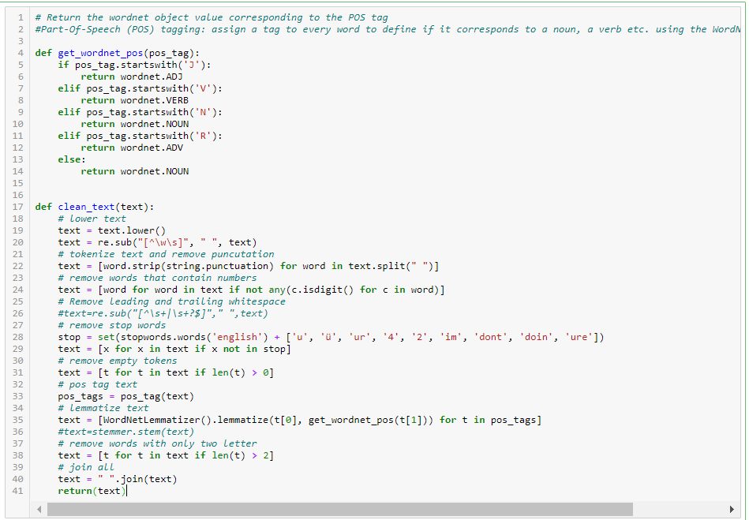
DATA PRE-PROCESSING
For Data pre-processing we did some data cleaning, where we used wordNet lemmatizer and porterStemmer to clean the words and removed special characters using Regexp Tokenizer and filter the words by removing stop words and then used lemmatizers and joined and return the filtered words.
Used TFIDF vectorizer to convert those text into vectors, and split the data and into test and train and trained various Machine learning algorithms.

Slide 4
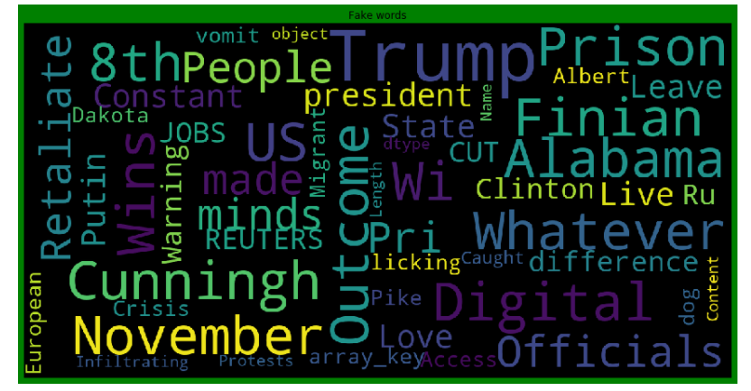
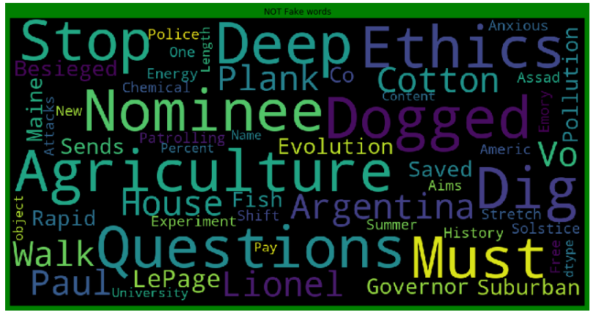
DATA INPUT- LOGIC-OUTPUT RELATIONSHIPS
FAKE WORDS
NOT FAKE WORDS
From the above we can see that most frequent words on both labels and we can observe the words which are leading to fake new are trump, Clinton, prison,november, etc and words which are leading to real news are said, agriculture,police ,questions etc, so we can clearly see that above dataset extensively deals with news around US presidential elections between Trump and Clinton.

Slide 5
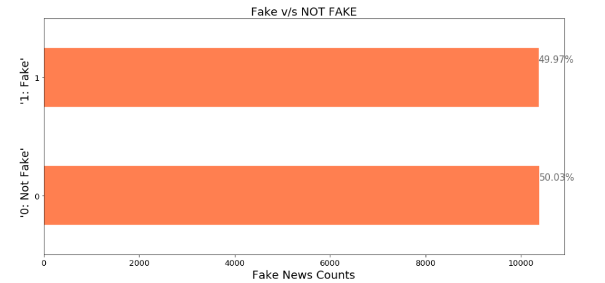
MODEL/S DEVELOPMENT AND EVALUATION
From the above we can see that the dataset is balanced which is good as it will help our model to classify more accurately, so we should expect good accuracy score, and as the volume of data was also good.

Slide 6
MODEL/S DEVELOPMENT AND EVALUATION
Testing of Identified Approaches (Algorithms)
RF=RandomForestClassifier()
LR=LogisticRegression()
MNB=MultinomialNB()
DT=DecisionTreeClassifier()
AD=AdaBoostClassifier()
XG=XGBClassifier()

Slide 7
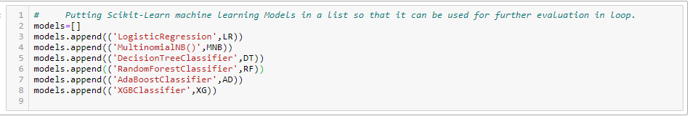
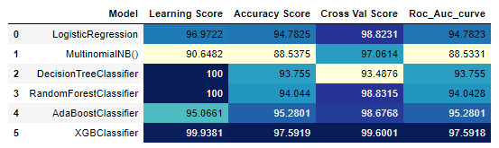
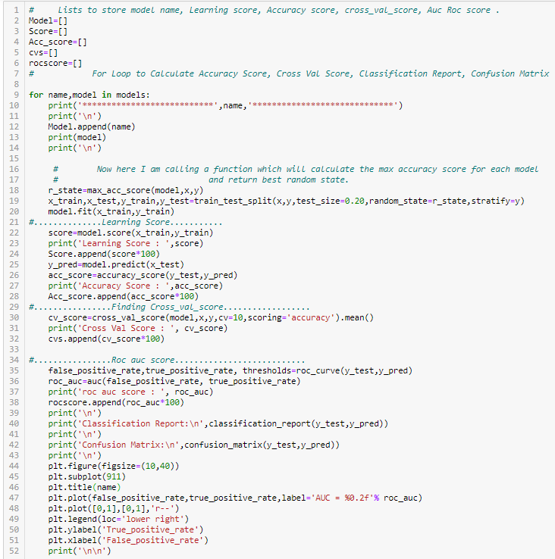
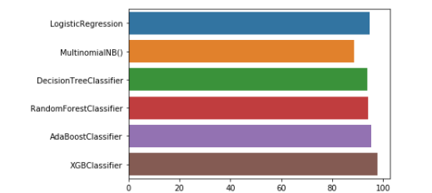
MODEL/S DEVELOPMENT AND EVALUATION
Run and Evaluated Some Selected models
Key Metrics for success in solving problem under consideration
From the above Metrics result It is clear that XGBClassifier is performing best for Roc-Auc, cross-val score and accuracy score metric.

Slide 8
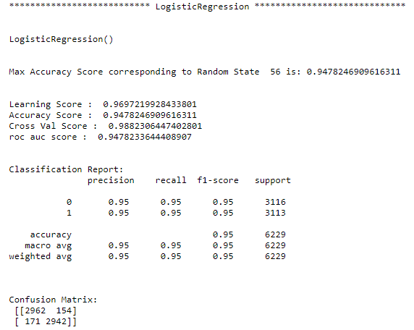
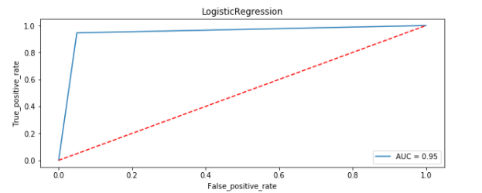
MODEL/S DEVELOPMENT AND EVALUATION
Logistic Regression Visualization:

Slide 9
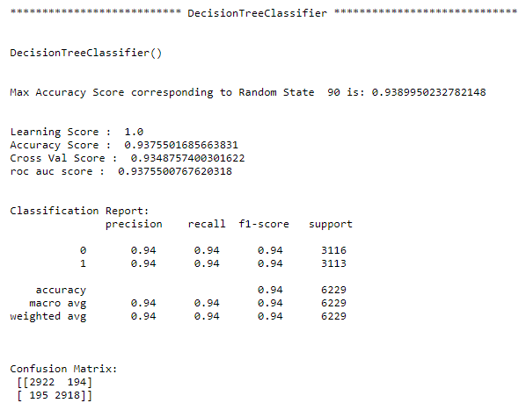
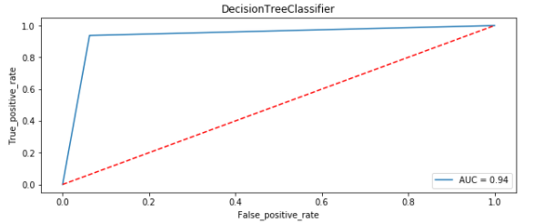
MODEL/S DEVELOPMENT AND EVALUATION
Decision Tree Classifier Visualization:

Slide 10
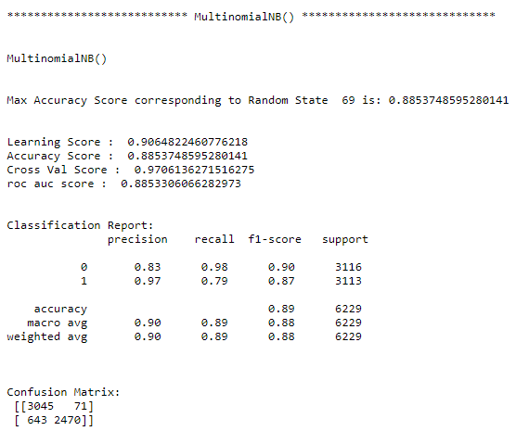
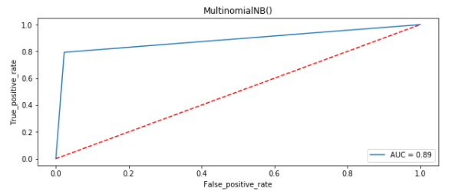
MODEL/S DEVELOPMENT AND EVALUATION
MultiNomial NB Visualization:

Slide 11
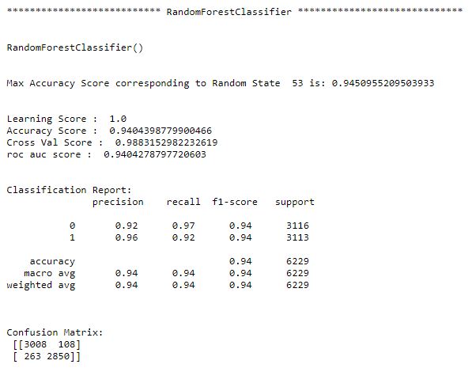
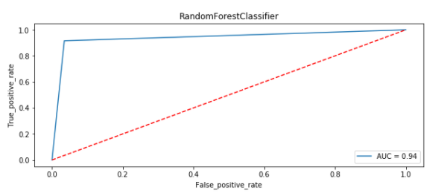
MODEL/S DEVELOPMENT AND EVALUATION
Random Forest Classifier Visualization:

Slide 12
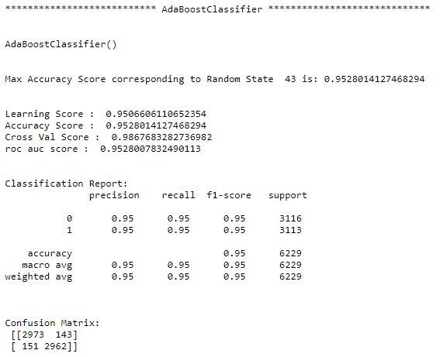
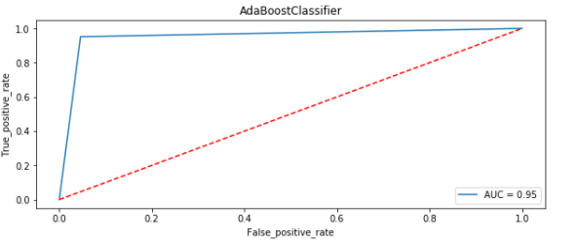
MODEL/S DEVELOPMENT AND EVALUATION
Ada Boost Classifier Visualization:

Slide 13
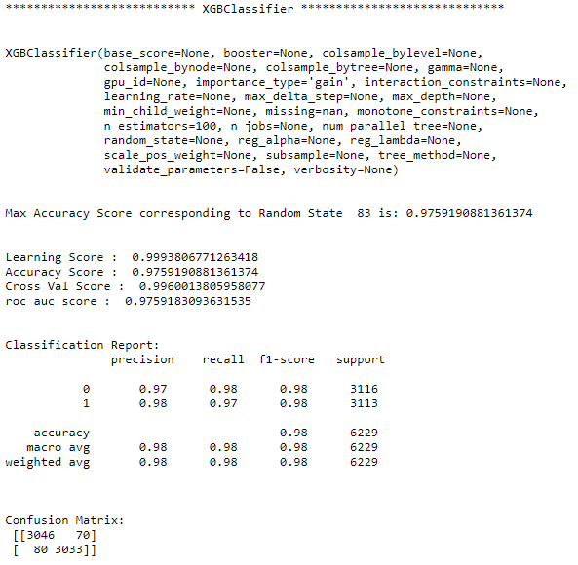
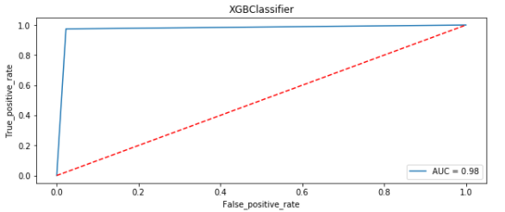
MODEL/S DEVELOPMENT AND EVALUATION
XGB Classifier Visualization:

Slide 14
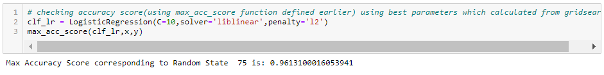
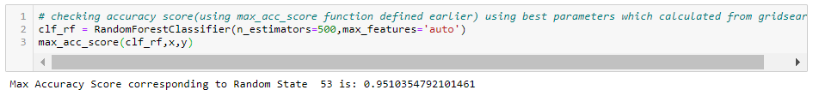
Hyper parameter tuning
After all this process conclusion is that XGB Classifier and Adaboost Classifier and Random Forest Classifier are performing well in terms of Accuracy score, Cross val score and Roc_Auc score as compared to other models.
After all this process conclusion of Hyper Parameter is that Random Forest Classifier is giving accuracy of 95.10%, but XGB Classifier is giving an accuracy of 97% without tuning. So now I am making a final model using XGB Classifier.

Slide 15
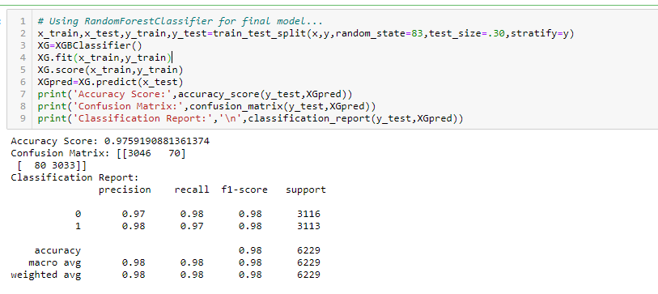
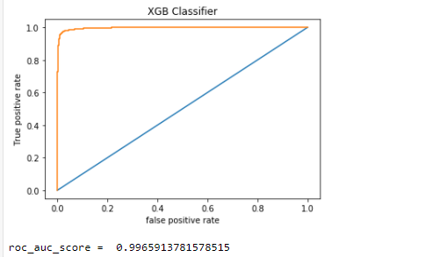
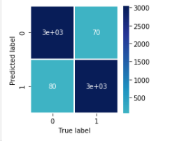
Final model
From the above visualization and matrices found that the XGB Classifier performed the best 99.6% AOC_ROC_SCORE, with precision accuracy score of 97% and recall 98%.

Slide 16
CONCLUSION
Key Findings and Conclusions of the Study
From the whole evaluation we can see that the maximum number of words in fake news were regarding Trump, and Clinton and we can interpret that it was due to election campaign which was held during US presential election and we know these adverse effects of the voters which were influenced by the fake news and most of the real news had said, trump and president, and fake news which was cleared by trump’s campaign, but can hardly see any clarity or real news from the side of Clinton, and due to which the impact we already saw on election results and regarding the election advertisement and news Facebook’s CEO Mark Zuckerberg also got extensively question by congress.

